Slide 1
Back Yard Cover Crops and Soil Secrets
Building, Increasing and Holding Fertility
www.homefoodsystems.com

Slide 2
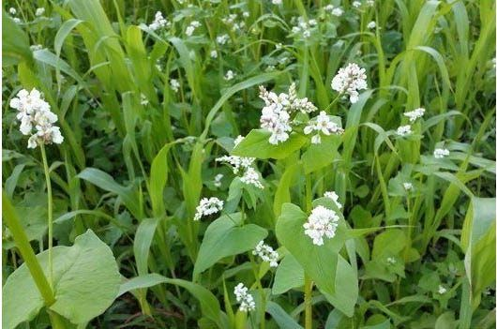
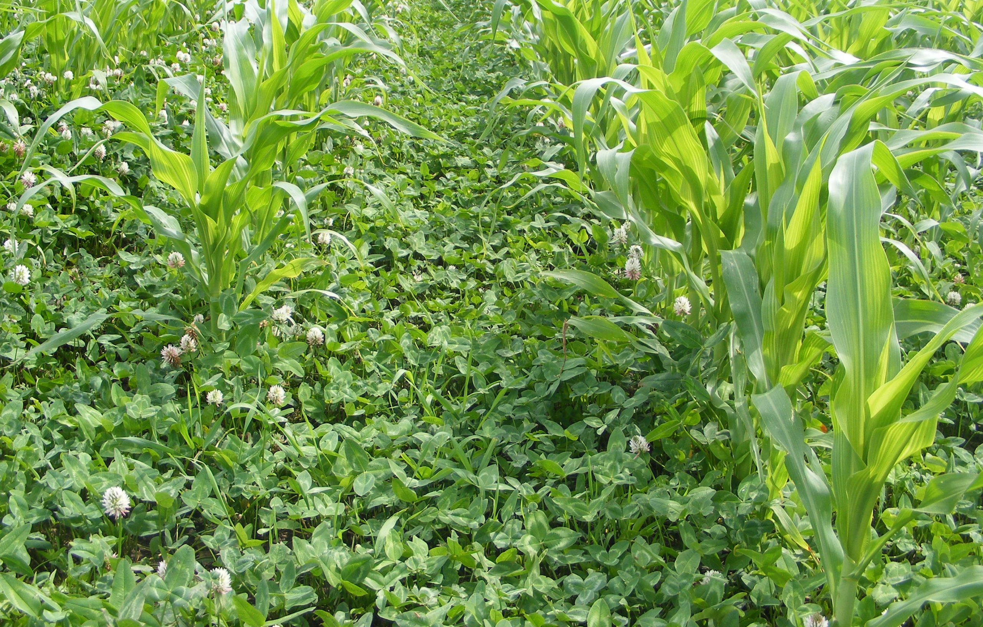
Chapter One – Introduction to the Concept & Soil Functions
What is a cover crop
How Long Have Humans Used Cover Crops
Washington and Jefferson lamented they were under used
Records in China and India go back 1000s of years
Before chem ag you either covered or you moved
Why do we use cultivated species for covers vs. weeds/wild plants
What is cover crop termination
What is “planting green”
Where does cover cropping work

Slide 3
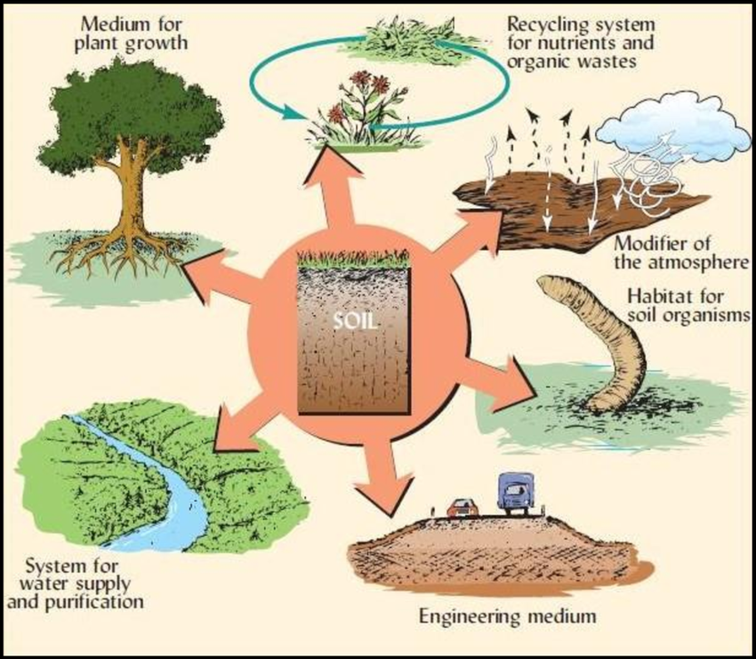
Chapter One – Introduction to the Concept & Soil Functions
The Six Functions of Soil
Growth Medium
Habitat for Soil Organisms
Supply and purify water
Engineering Medium
Recycle Nutrients and Organic Matter
Atmosphere Modifier

Slide 4
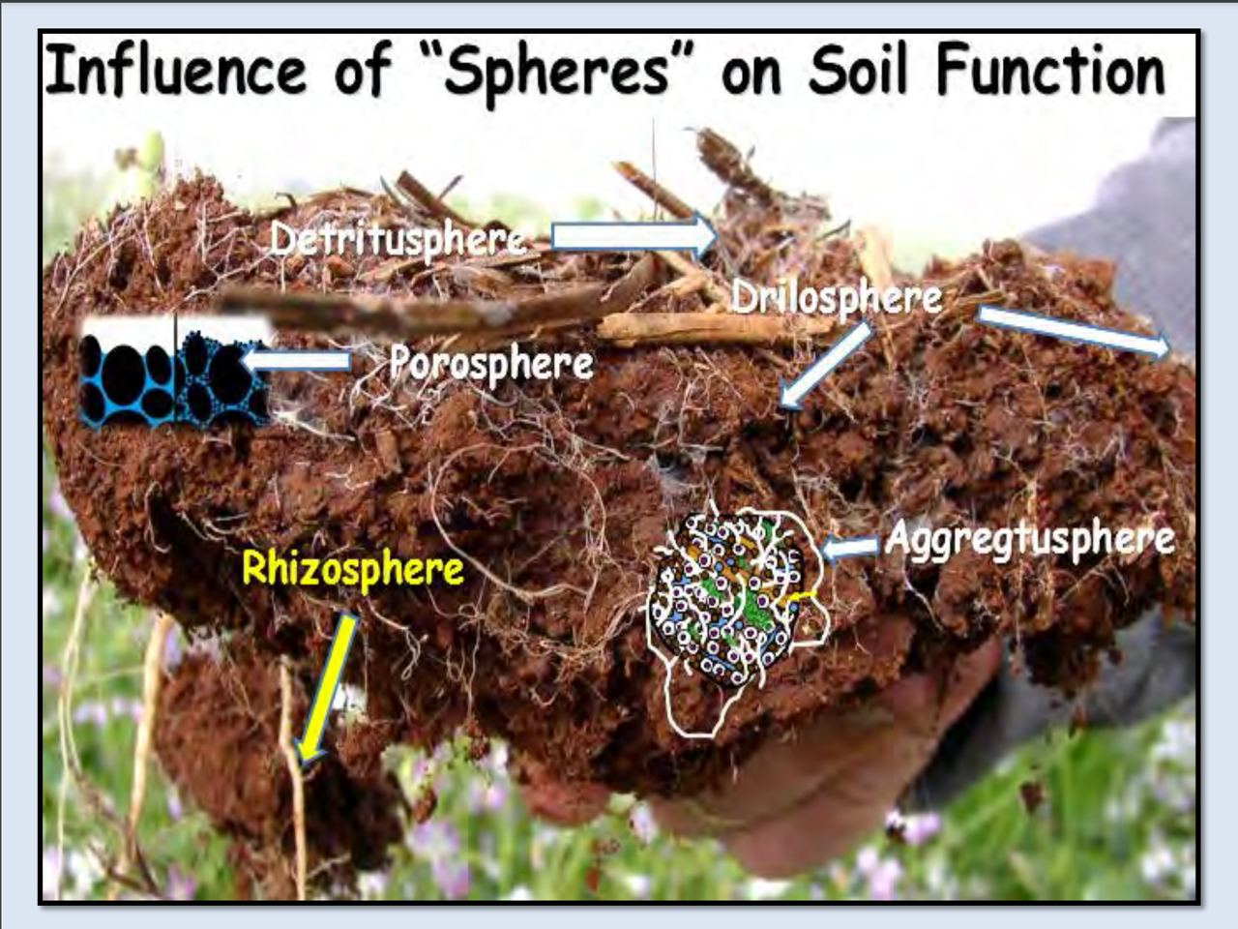
Chapter One – Introduction to the Concept & Soil Functions
The Spheres of the Soil
Detritussphere
Drillosphere
Rhizosphere
Aggregtusphere
Porosphere

Slide 5
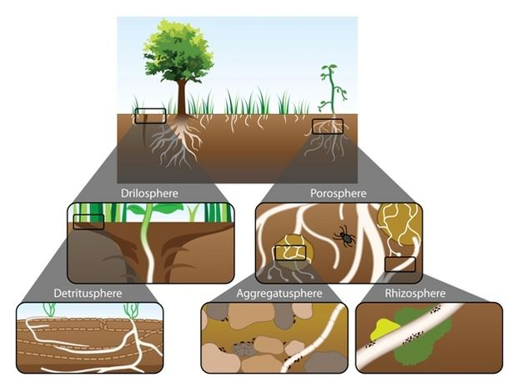
Chapter One – Introduction to the Concept & Soil Functions
The best testing equipment you have
A shovel – all spheres present
Water – should infiltrate and retain
Your eyes – we know good soils when we see them
Your hands – we know good soils when we touch them
Your nose – we know good soils when we smell them

Slide 6
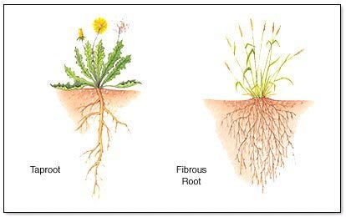
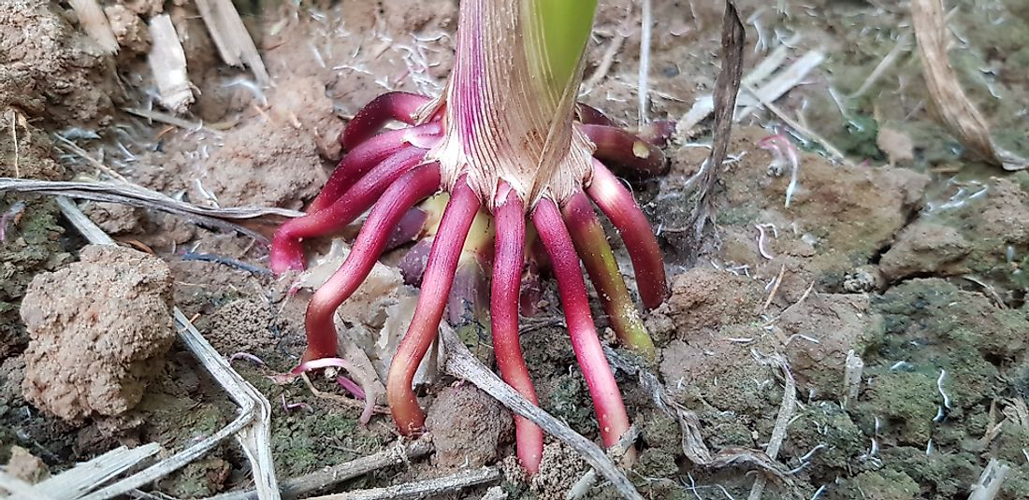
Chapter One – Root Types, Functions and Patterns
Three Primary Root Types
Tap
Fibrous
Adventitious
There are other terms like “hairnet” but they are not actual classifications.
We should select mixes for depth and structure diversity
About 50% of biomass is below grade
Roots are where the carbon exchange happens
Roots are a “battery” for the plant

Slide 7
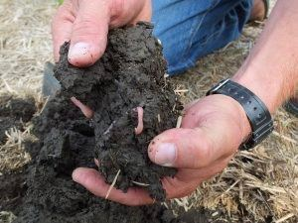
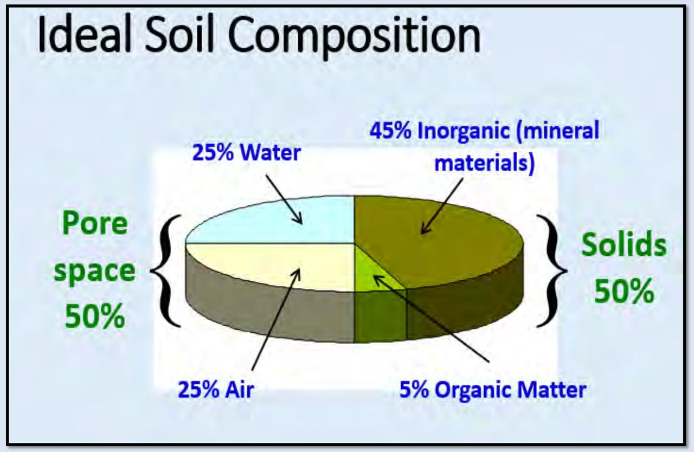
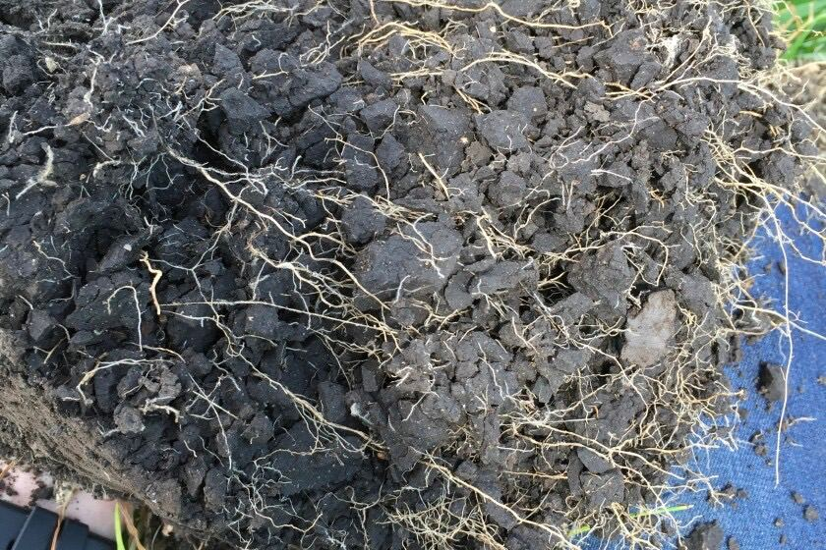
Chapter One – Introduction to the Concept & Soil Functions

Slide 8
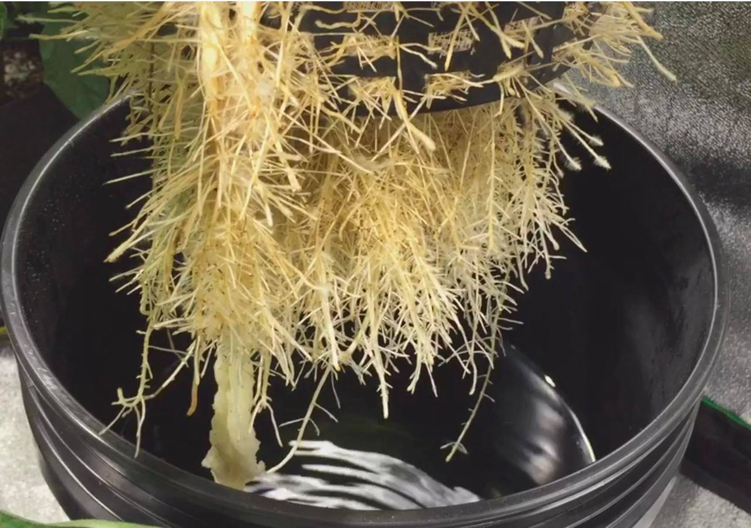
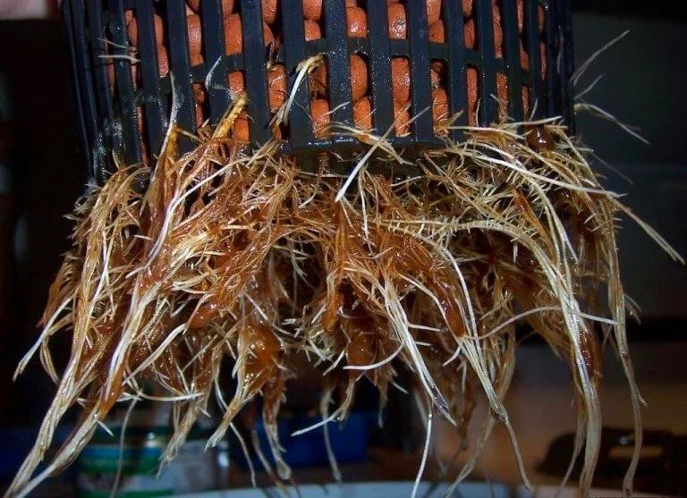
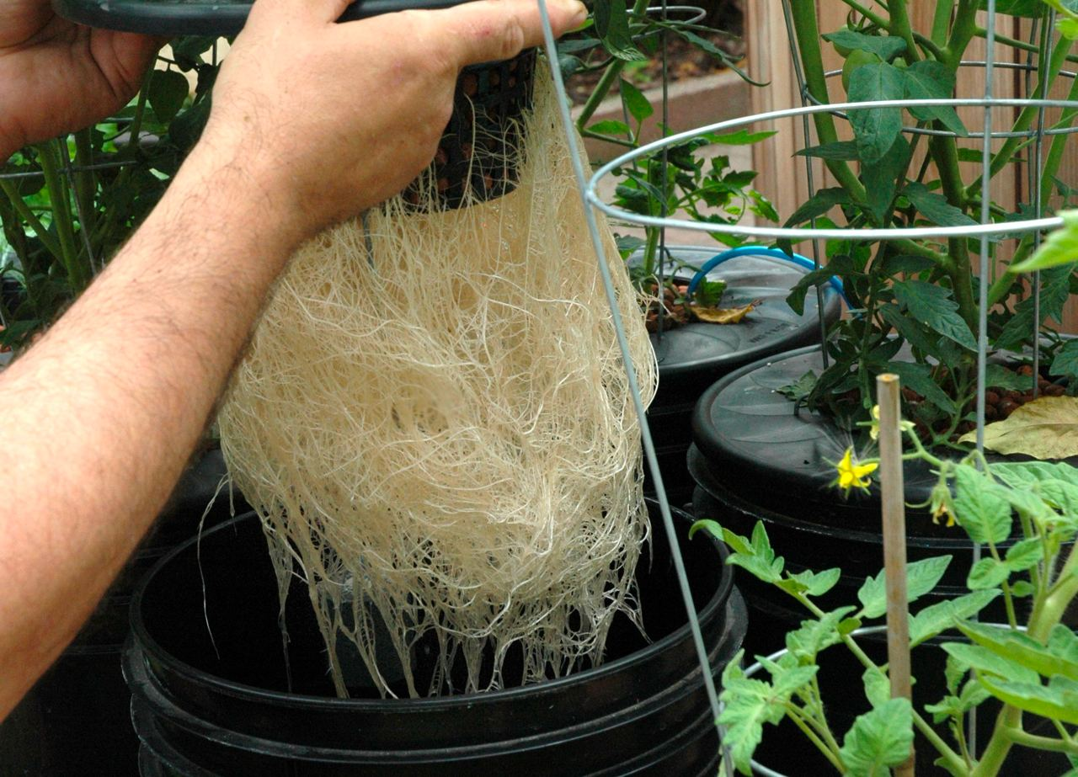
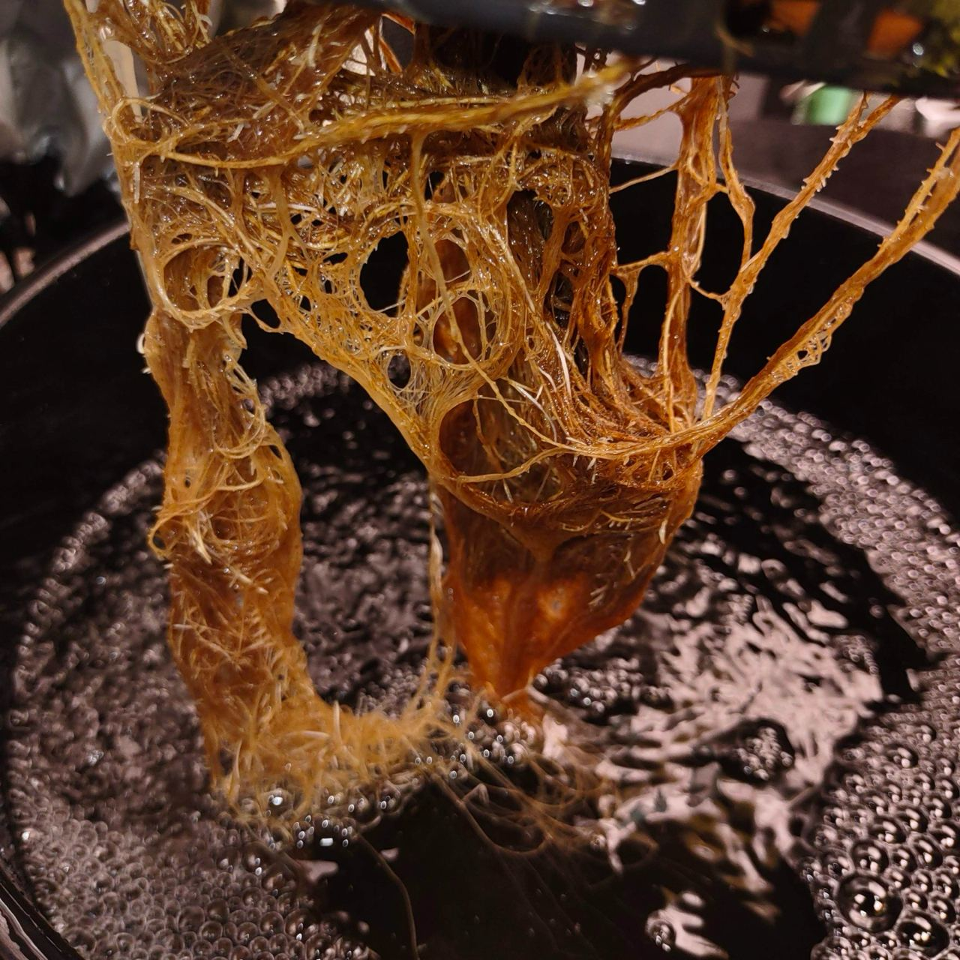
Chapter One – Introduction to the Concept & Soil Functions
The Importance of Air Space
These images are from hydro systems
The left images have good air flow
The right images have poor air flow
Plants grown in soil are not different
They need the same things
Air
Microbes
Nutrients
Which of these root systems?
Looks healthy to you
Do you want in your garden
Looks better able to fight diseases
Can better access nutrients

Slide 9
Back Yard Cover Crops and Soil Secrets
Building, Increasing and Holding Fertility
www.homefoodsystems.com
End of Chapter One

Slide 10
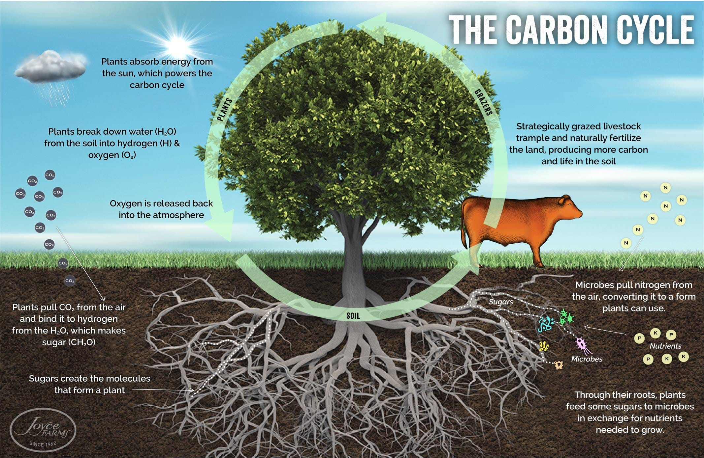
Chapter Two - The Role of Biology in the Carbon & Water Cycles

Slide 11
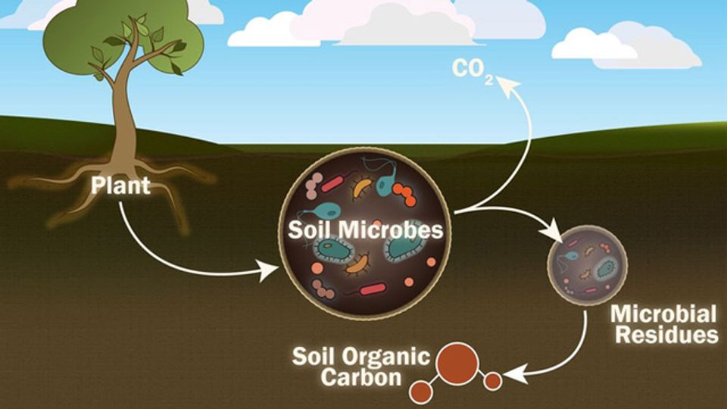
How Plants Move Carbon to the Soil and Microbes Lock it Up

Slide 12
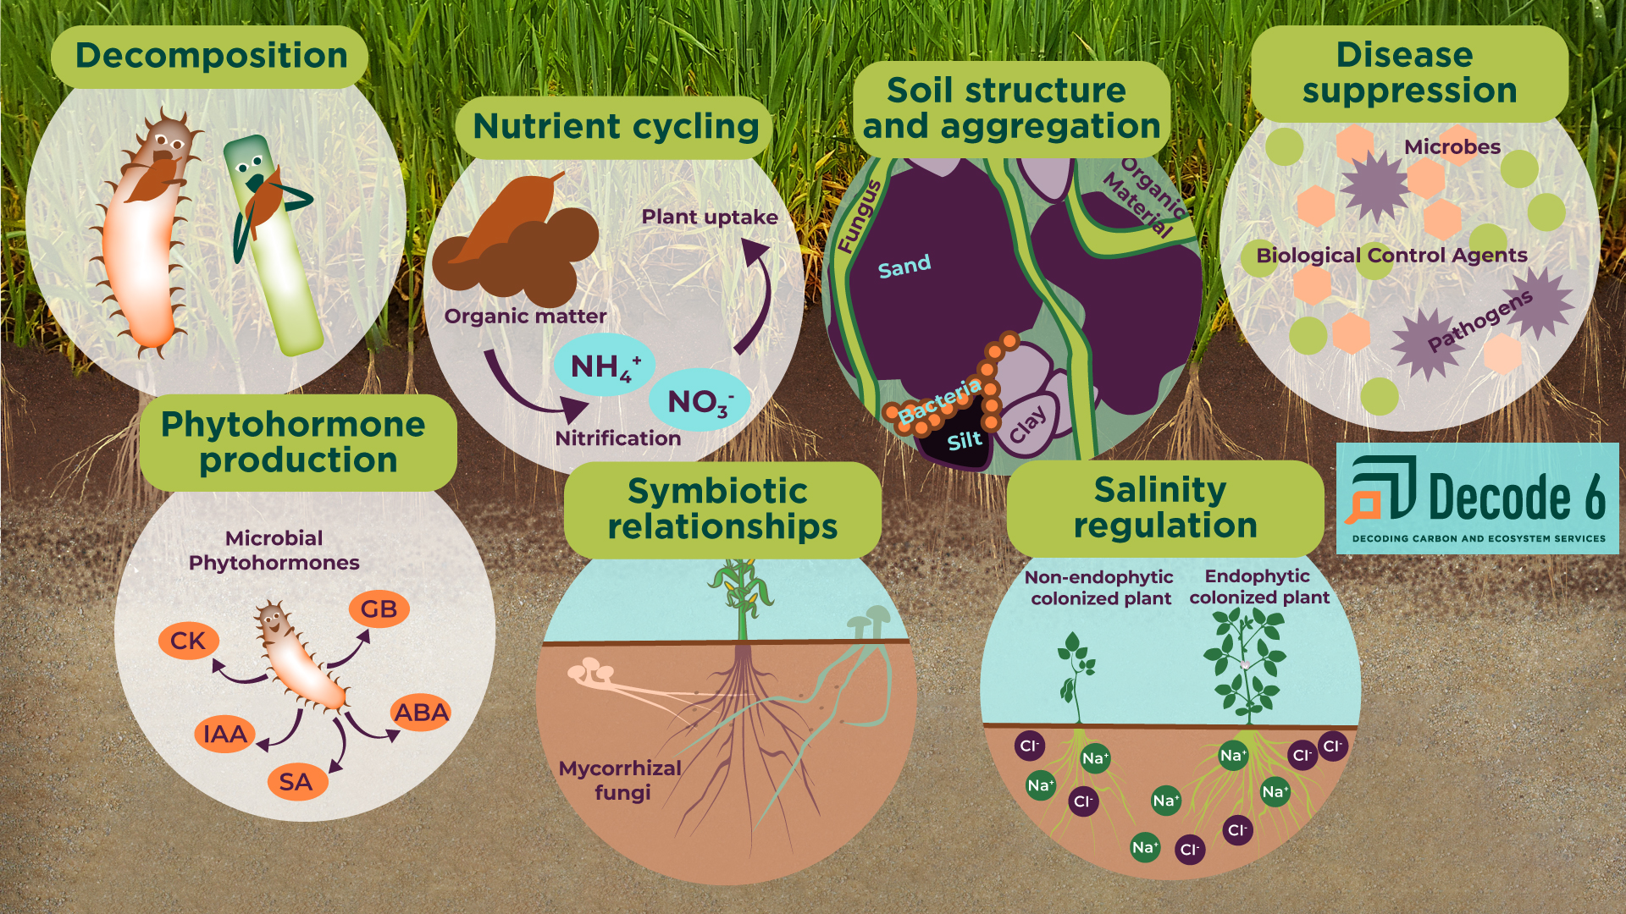
What Increased Carbon Does for Soil Biology

Slide 13
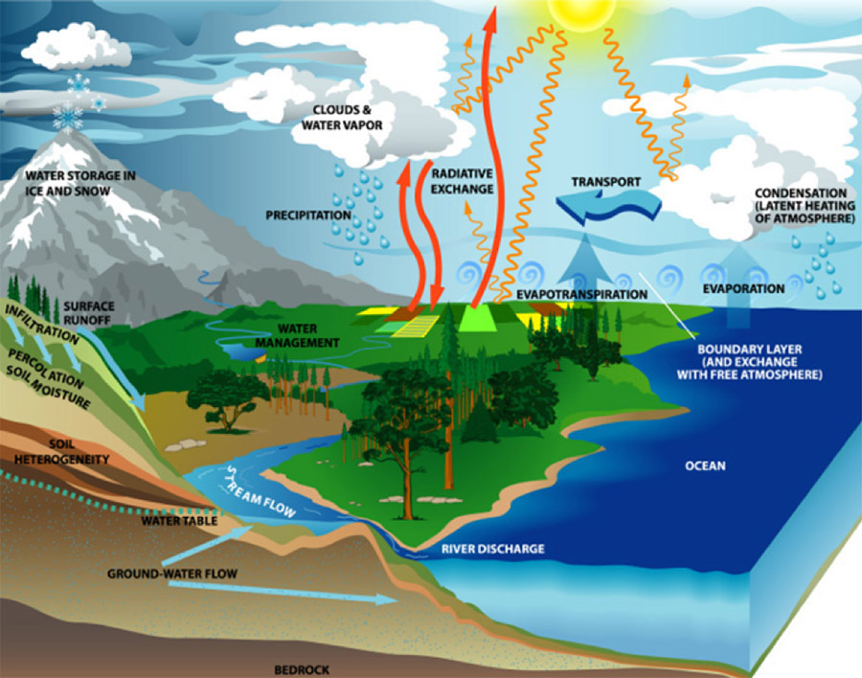
How the Long Water Cycle Functions in Healthy Systems
Evaporation
Condensation
Sublimation
Precipitation
Transpiration
Runoff
Infiltration

Slide 14
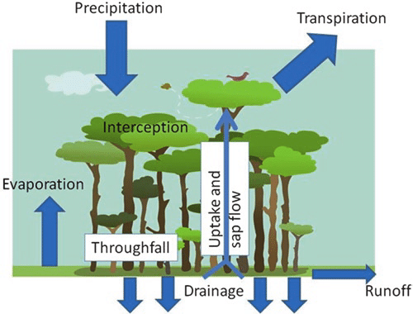
How the Small Water Cycle Functions in Healthy Systems
Requires the same soil structure for infiltration, etc.
Water does not reach major rivers and oceans
Much is transpired by plants especially trees & shrubs
Is as important as the long cycle (oceanic)
Often referred to as the terrestrial water cycle or the hydrological cycle.

Slide 15
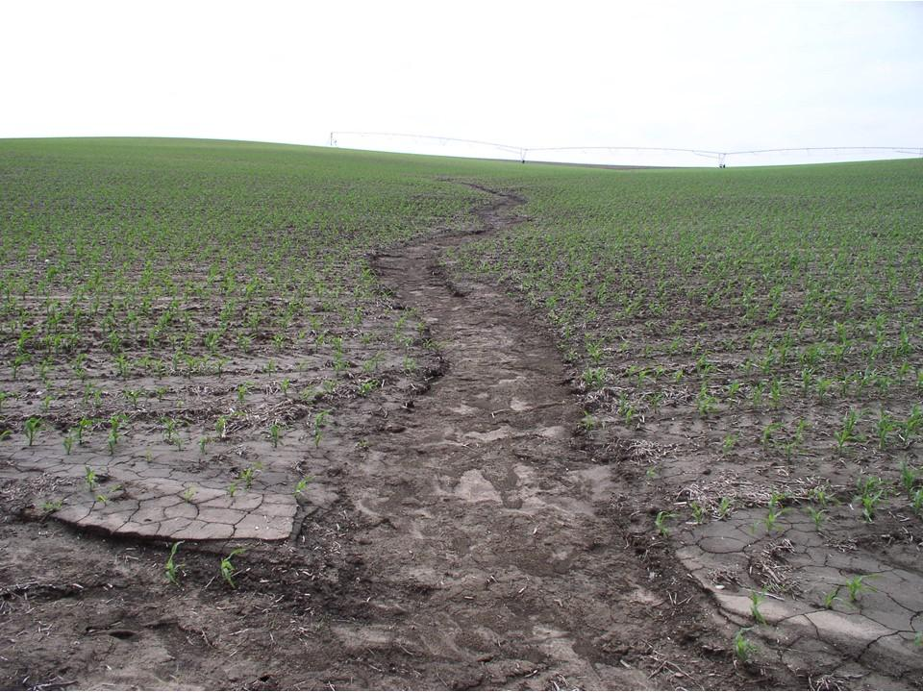
Many Farms Have Almost as Much Run Off as A Parking Lot
Compacted ground shed water
The water cuts channels
The channels move more water faster
The ground becomes dryer
Much of the rain falls when the ground is bare or almost bare
When the heat comes the ground is baked
Compaction increases
This is the new cycle we have created, I call it the top soil removal cycle

Slide 16
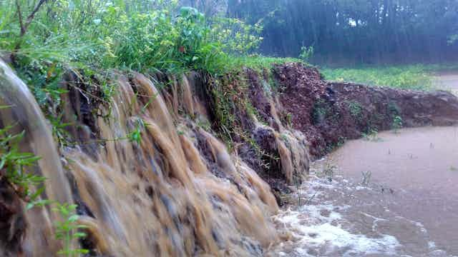
Buffers Don’t Really Work Without a Healthy Water Cycle
Once water starts moving across the land it will down trees, sweep grass flat, find and create new channels, etc.
Every inch that falls on one acre of water shed is over 27,000 gallons of water, if infiltration is poor, much of it runs across the surface.
If you are catching even just 10 acres of rain at 1 inch, you are asking a riparian strip to infiltrate almost 300,000 gallons of water.
An airplane flight in spring across he nation will show you just how bad the problem is.

Slide 17
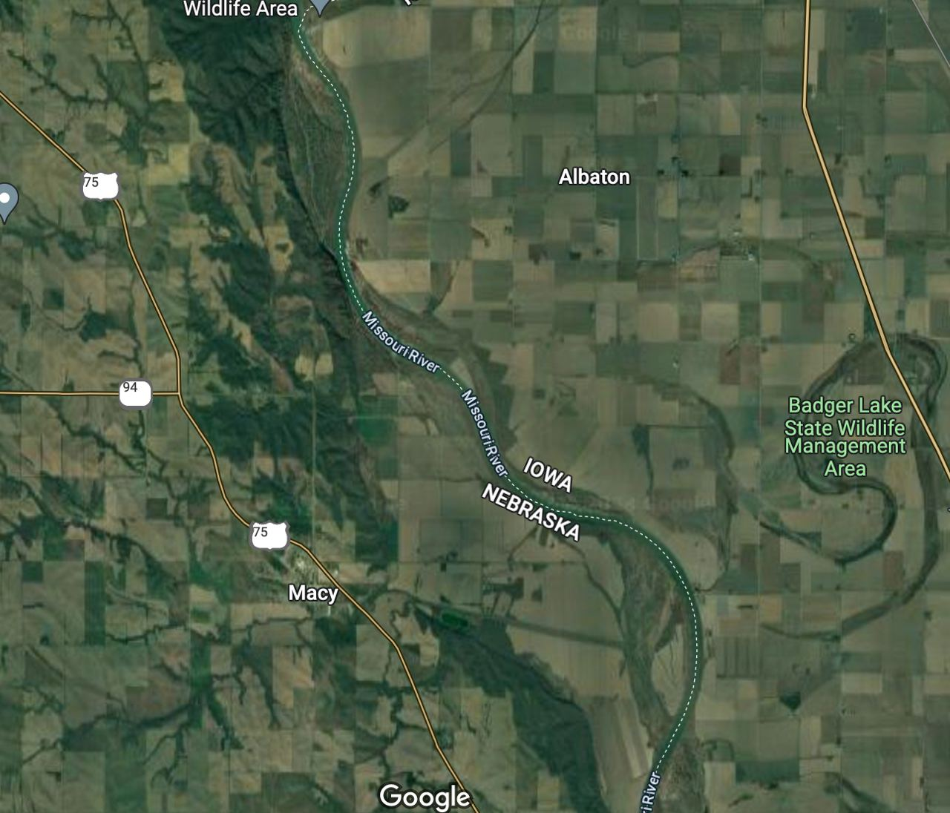
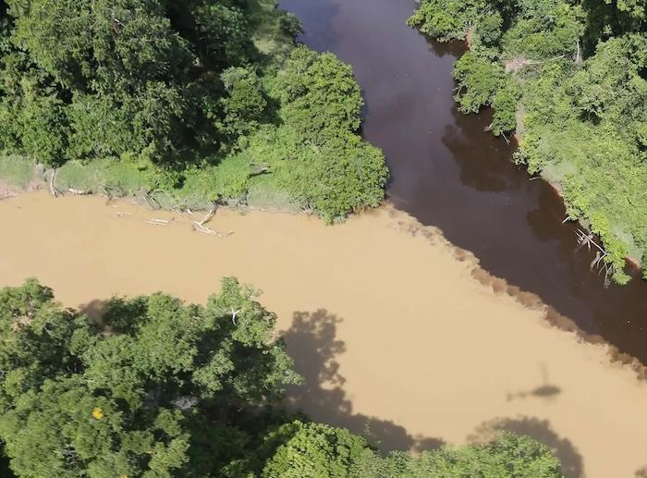
Buffer Strips are Simply Over Loaded

Slide 18
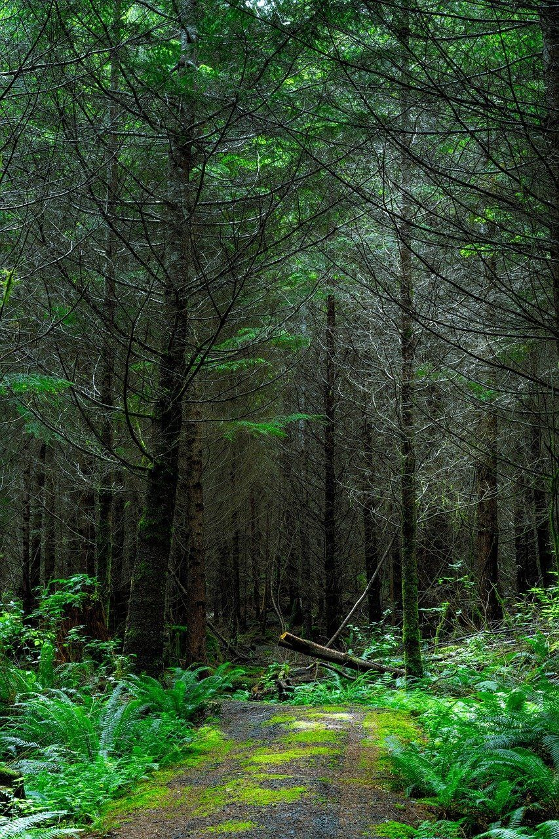
The Forest Floor is a Lake
To have a healthy system and complete water cycle the water must infiltrate and move though the land and be held by it.
This requires healthy soil structure, organic matter, soil microbes and covered soils.
We are back to our 5 soil spheres
Detritussphere
Drillosphere
Rhizosphere
Aggregtusphere
Porosphere
Remember healthy soil is ideally 25% air and 25% water. In other words 50% space.
Soil can only be structured this way by the actions of microbes and plant roots

Slide 19
Back Yard Cover Crops and Soil Secrets
Building, Increasing and Holding Fertility
www.homefoodsystems.com
End of Chapter Two

Slide 20
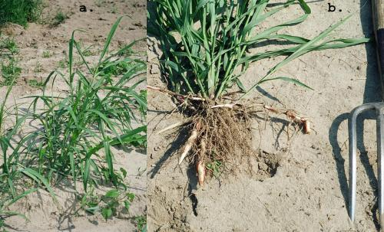
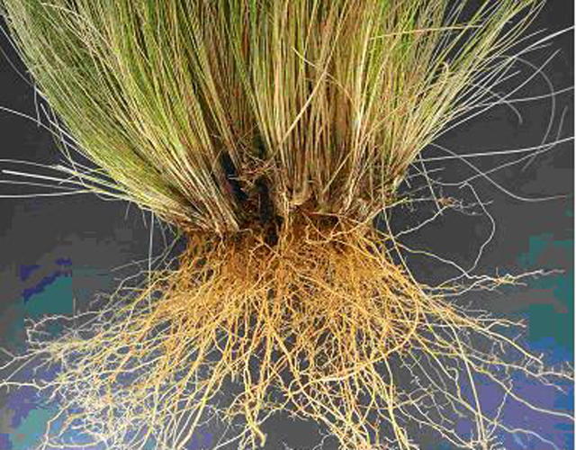
Chapter Three – Tillage vs. Healthy Soils
What Happens When We Till – Hair Net Weeds are Germination Triggered

Slide 21
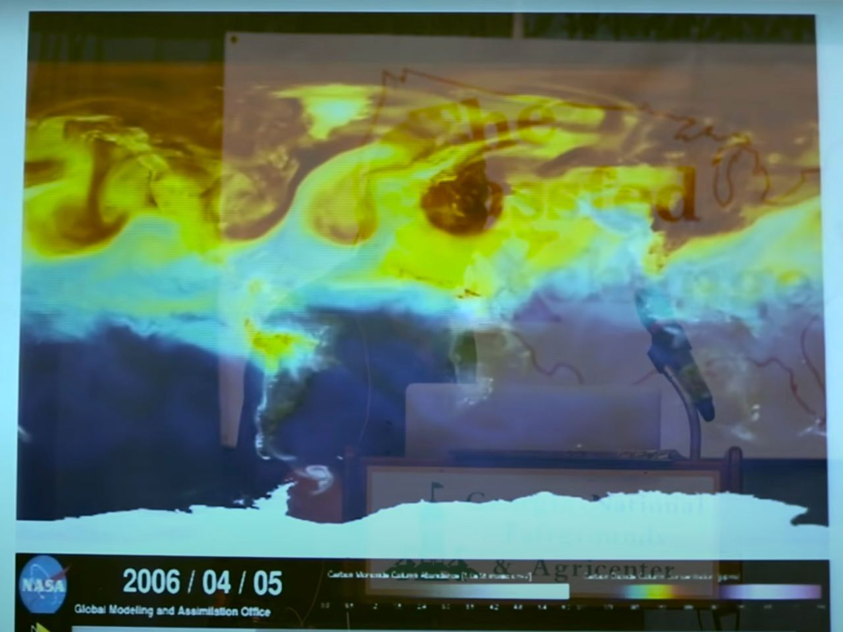
Chapter Three – Tillage vs. Healthy Soils
What Happens When We Till – Carbon is Released into the Atmosphere

Slide 22
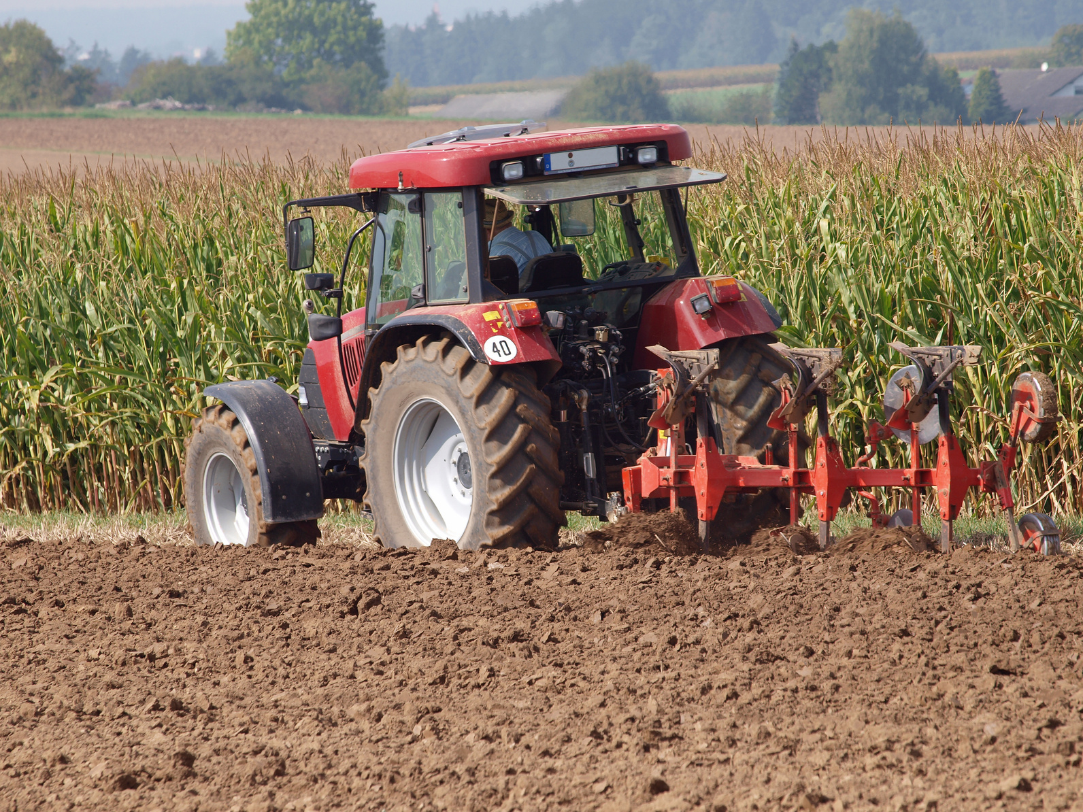
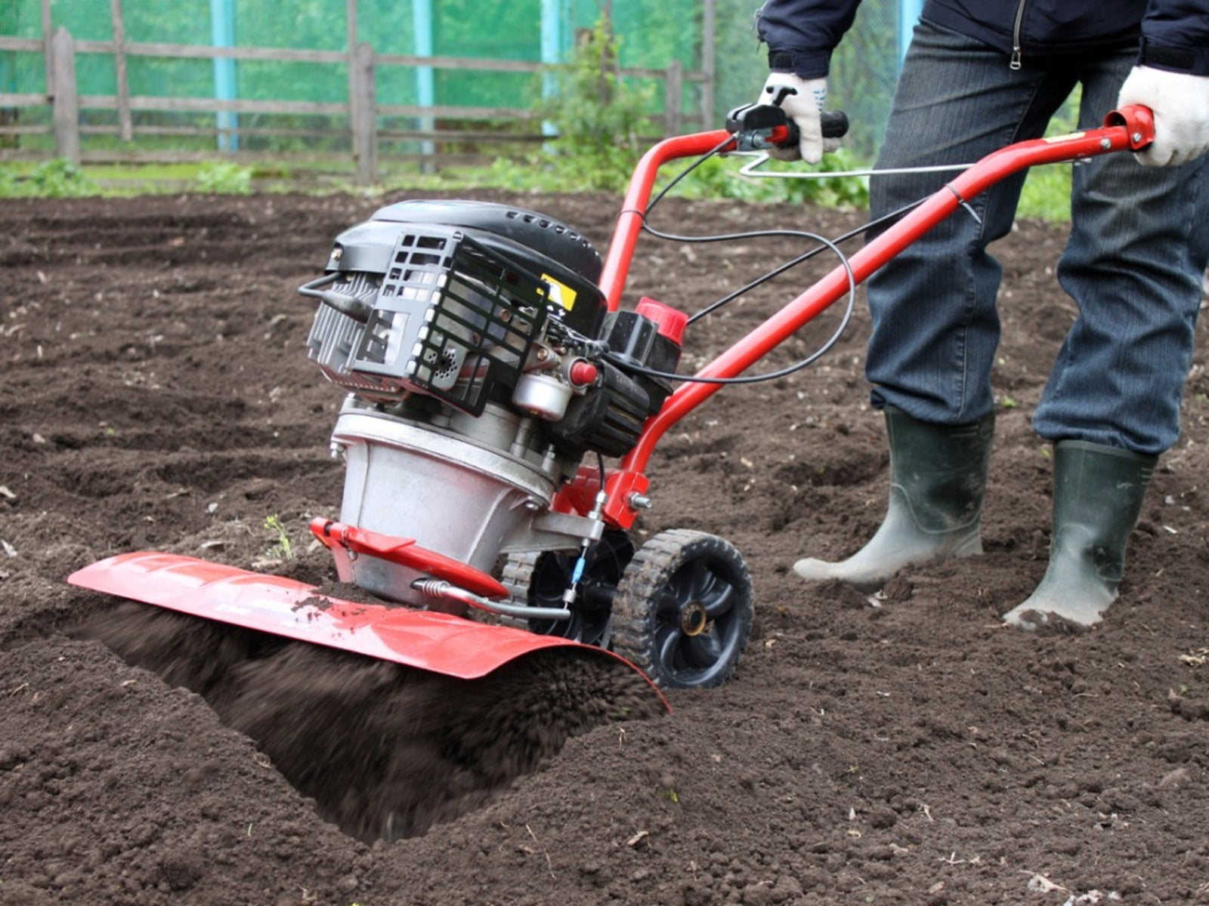
Chapter Three – Tillage vs. Healthy Soils
What Happens When We Till – With Very Few Living Roots Left the Carbon Cycle is Disrupted

Slide 23
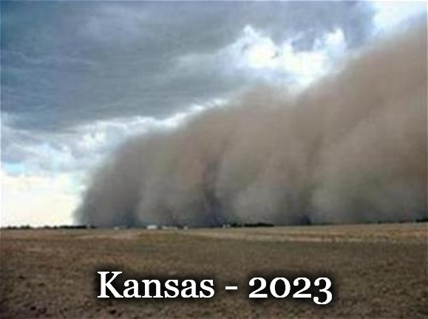
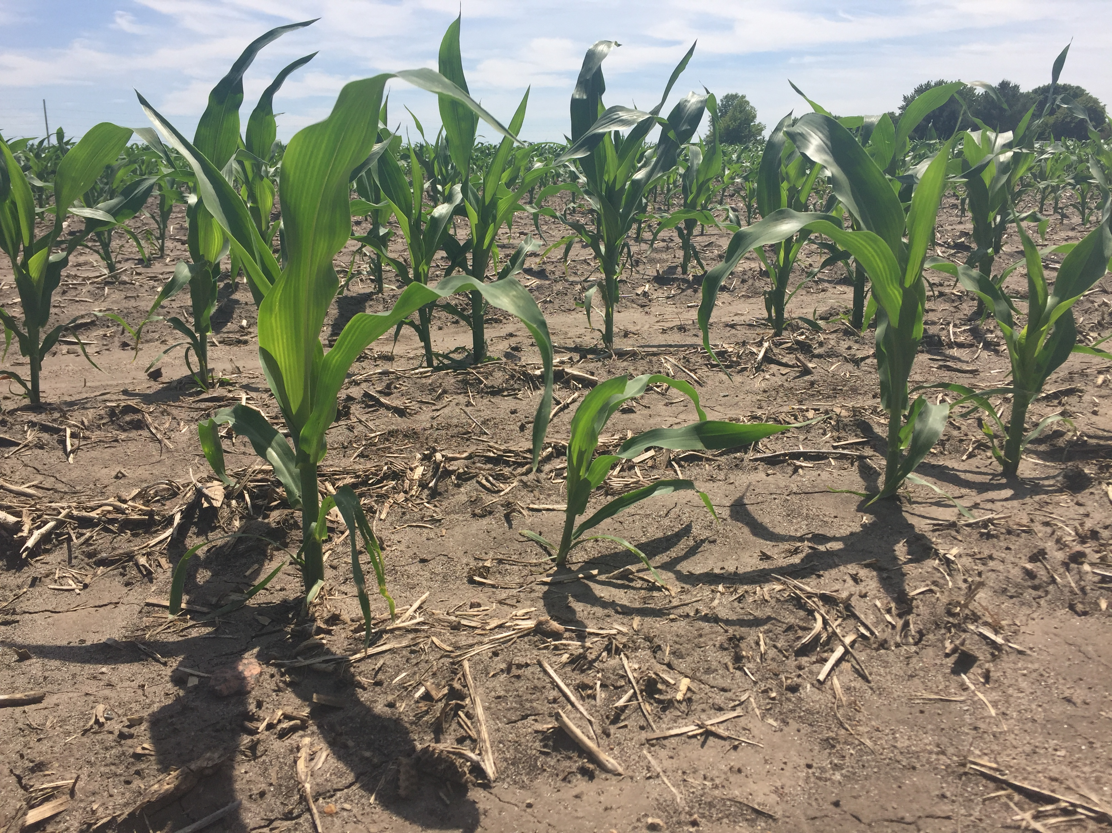
Chapter Three – Tillage vs. Healthy Soils
What Happens When We Till – Soil is Loose at First and Blows/Washes Away Then Compacts

Slide 24
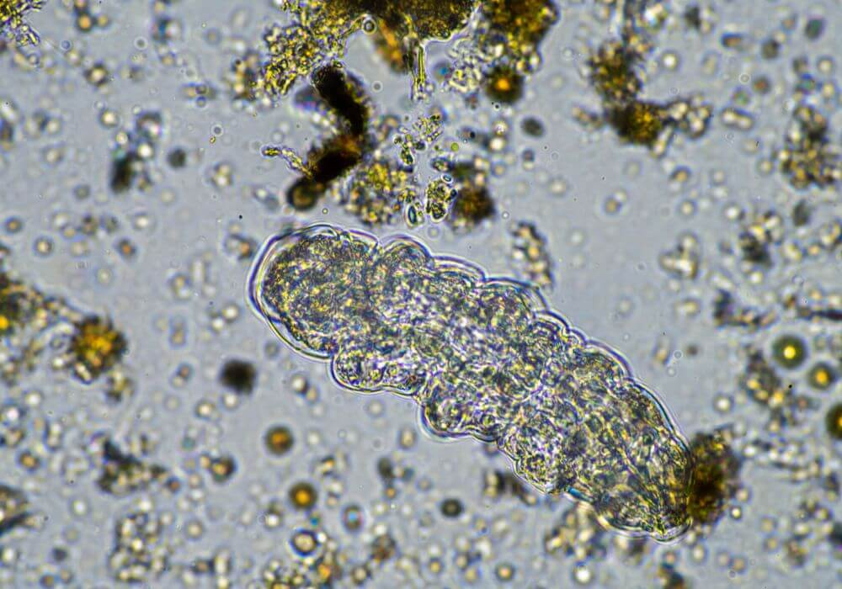
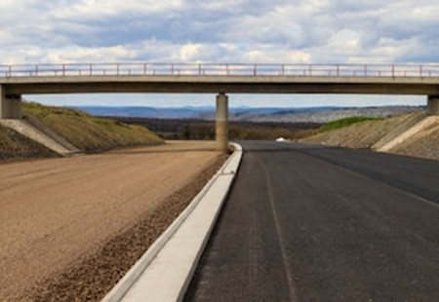
Chapter Three – Tillage vs. Healthy Soils
What Happens When We Till – R-Strategist Bacteria Explode in Population Consuming Organic Matter

Slide 25
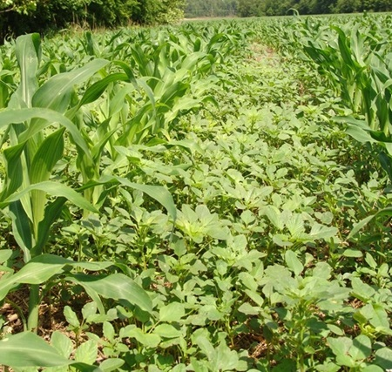
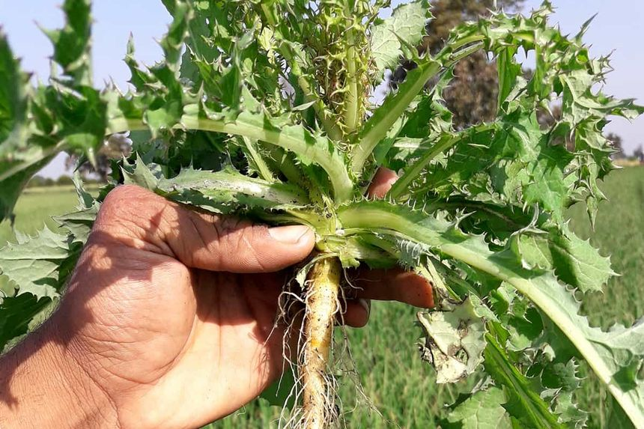
Chapter Three – Tillage vs. Healthy Soils
What Happens When We Till – Tap Root Weeds Are Triggered to Germinate

Slide 26
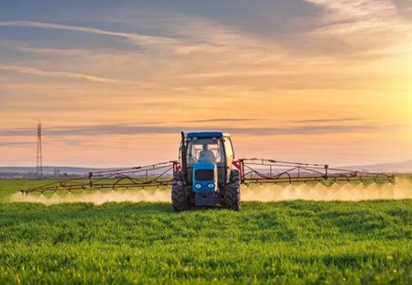
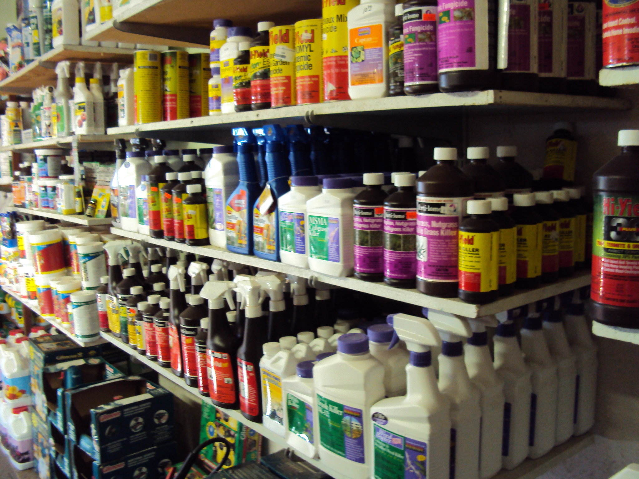
Chapter Three – Tillage vs. Healthy Soils
What Happens When We Till – Herbicide, Pesticide, Fungicide & Fertilizer are Needed for Therapy

Slide 27
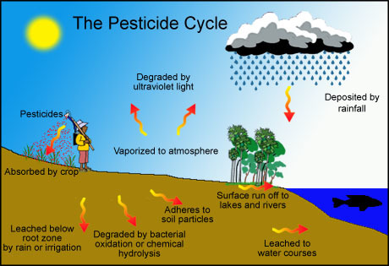
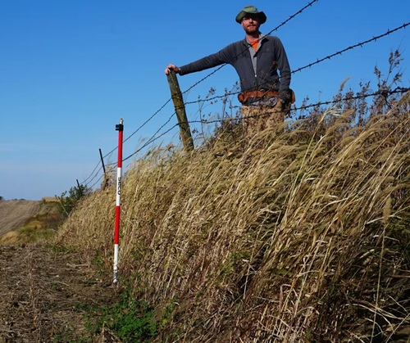
Chapter Three – Tillage vs. Healthy Soils
What Happens When We Till – The Cycle We Don’t Want Continues

Slide 28
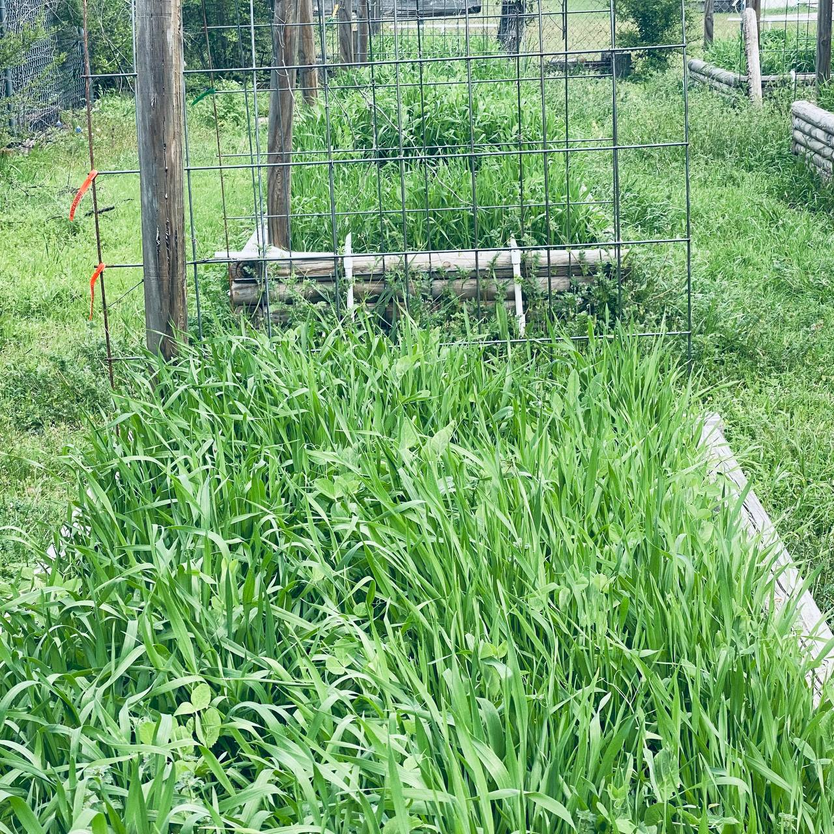
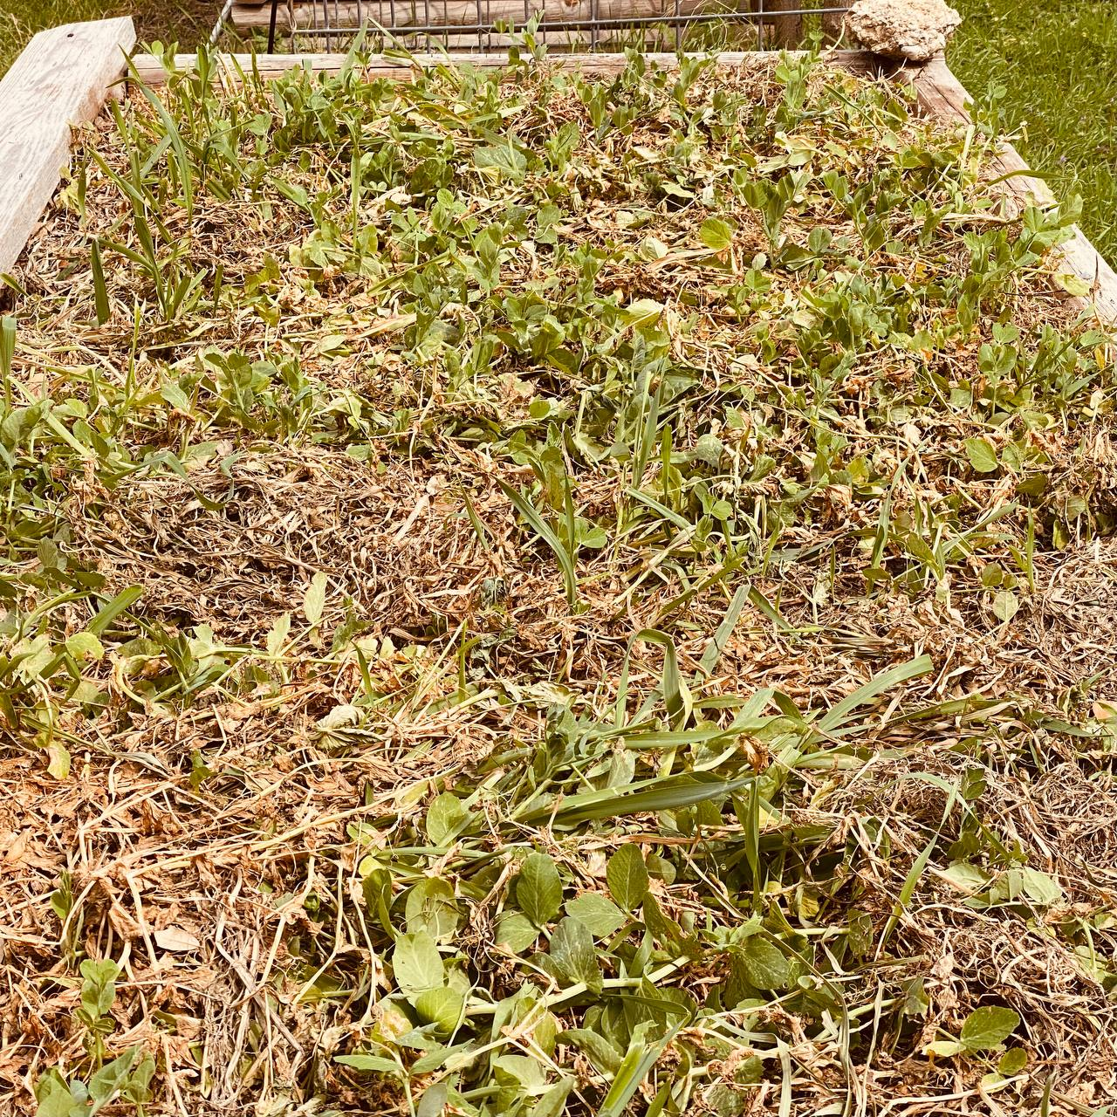
Chapter Three – Tillage vs. Healthy Soils
How Do We Protect the Soil – Keep Armor on the Soil at all Times

Slide 29
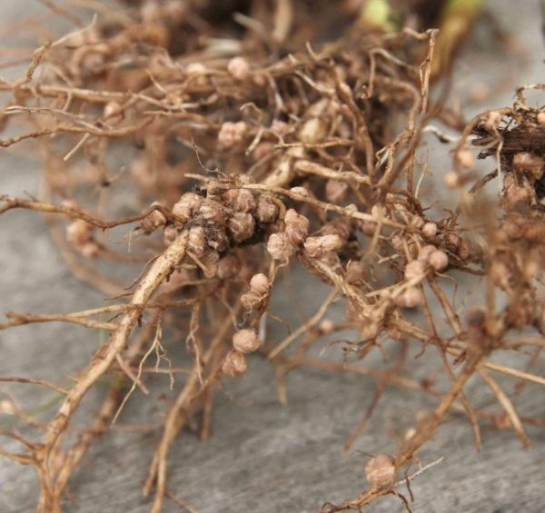
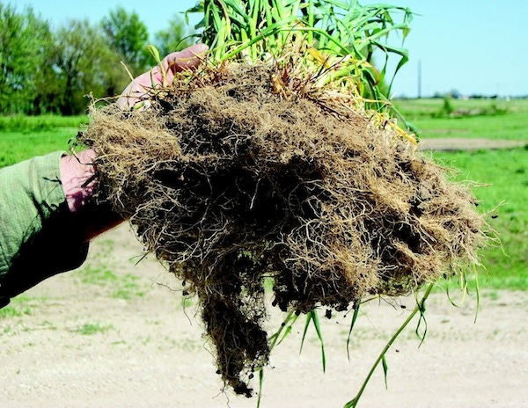
Chapter Three – Tillage vs. Healthy Soils
How Do We Protect the Soil – Keep Living Roots in the Soil as Long as Possible

Slide 30
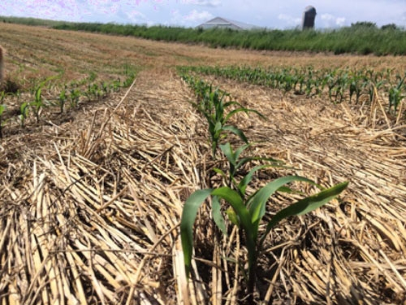
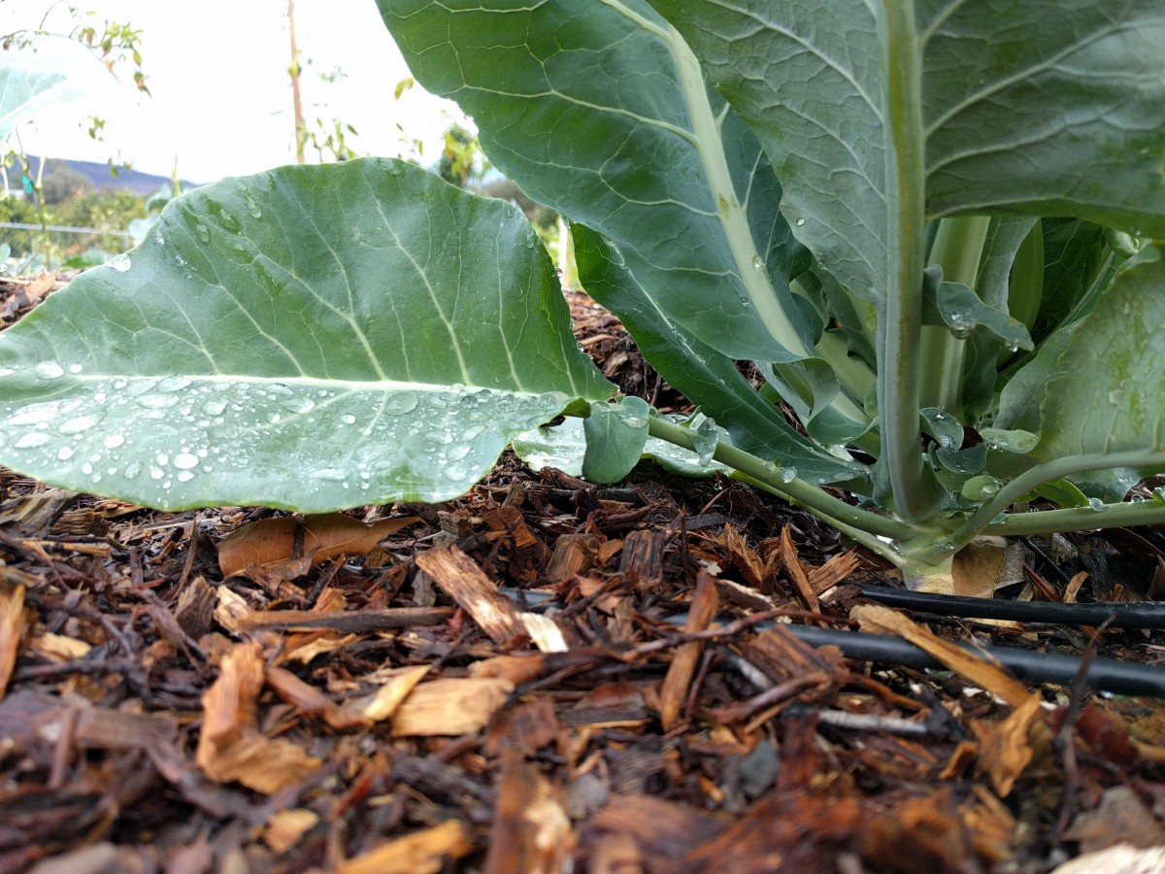
Chapter Three – Tillage vs. Healthy Soils
How Do We Protect the Soil – Stop Tilling and Use Minimal Disturbance

Slide 31
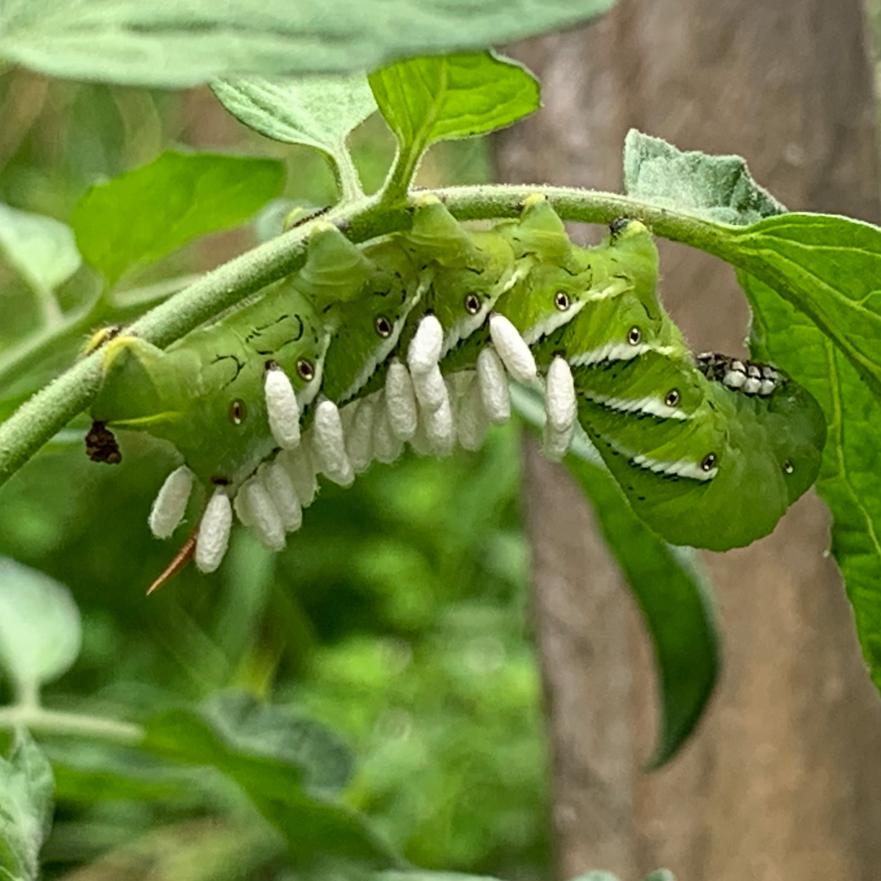
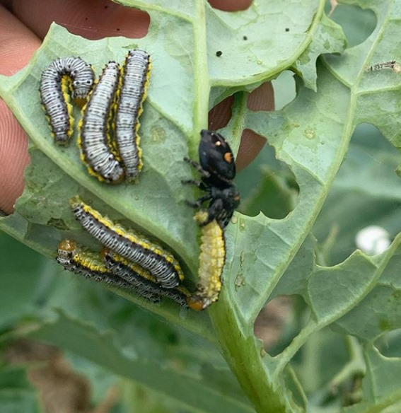
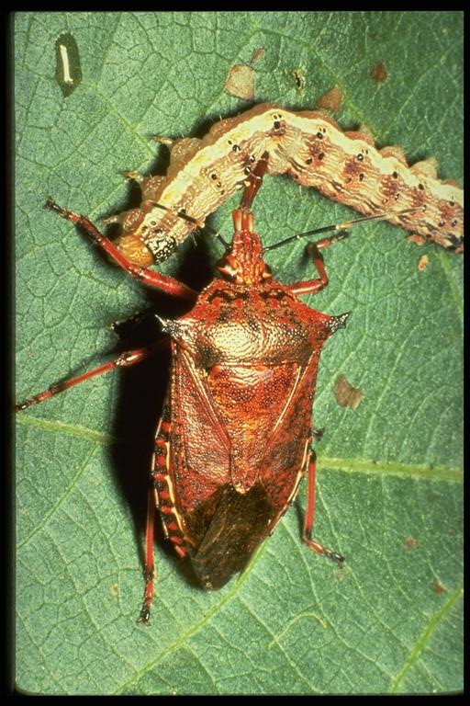
Chapter Three – Tillage vs. Healthy Soils
How Do We Protect the Soil – Stop Using the Chemical “Cocktails of the Cides” (killers)

Slide 32
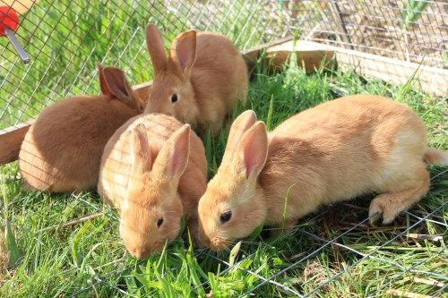
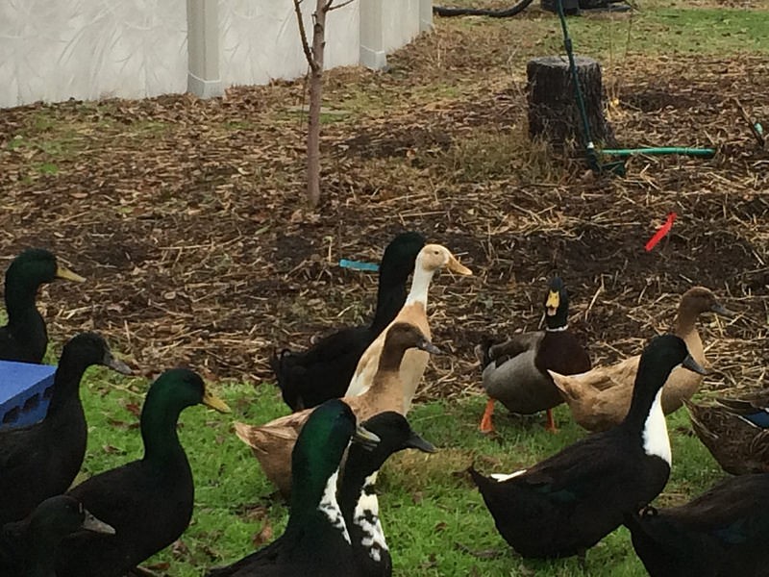
Chapter Three – Tillage vs. Healthy Soils
How Do We Protect the Soil – Integrate Animals into Your Systems

Slide 33
Chapter Three – Tillage vs. Healthy Soils
How Do We Protect the Soil – Integrate Animals into Your Systems

Slide 34
Chapter Three – Tillage vs. Healthy Soils
How Do We Protect the Soil – Use Diversity in Plantings and Covers
“Diversity is the Software of the Planet” ~Ray Archuleta

Slide 35
Chapter Three – Tillage vs. Healthy Soils

Slide 36
Back Yard Cover Crops and Soil Secrets
Building, Increasing and Holding Fertility
www.homefoodsystems.com
End of Chapter Three

Slide 37
Chapter Four – Fall/Winter Cover Crop Options
The King of Winter Cover Crops – Cereal Rye
What to Know
If you made me pick only one winter cover this is it
The root systems are huge
Highly cold tolerant (survives temps as low as -35F)
Can be mowed and regrow in winter
Can become weedy as it will self reseed
Is mildly allelopathic (small very shallow seeds only)
Is the number one cover crop in commercial farming
Can have “residue issues” (lack of soil fungus main cause)
Chop and drop is not effective when terminating
Produces lots of organic matter (mostly C, little N)
Can be your only winter cover, but that is not ideal
Seeding rate is only about .15-.25 pounds per 100 SF

Slide 38
Chapter Four – Fall/Winter Cover Crop Options
The Queen of Winter Cover Crops – Winter Pea
What to Know
If I had to use only two winter covers it would be pea/rye
Roots are more shallow than cereal rye
As a legume if inoculated it produces a lot of nitrogen
It pairs beautifully with rye providing N for rye’s C
Rye also provides excellent vertical structure for peas
It is edible including shoots and tendrils
Relatively easy to terminate but likes to “stand back up”
If allowed to flower/seed it uses some of the fixed N
Cold tolerant if established to at least 10F
I’ve had it survive below 0 temps
Grows very rapidly
Provides a lot of biomass

Slide 39
Chapter Four – Fall/Winter Cover Crop Options - Grasses
Treat them all basically the same but
Adjust planting times based on your climate
Use what you can get locally
Triticale is the most cold hardy of all grain/grasses
The freeze thaw cycle does effect survival
Should be terminated at the milk stage
All have huge root systems (great)
White cayuse oats have massive root clods
Oats tend to be the most difficult to terminate
I prefer a mix to any single grass (Barley/Triticale)
If you broadcast harrow with compost/mulch

Slide 40
Chapter Four – Fall/Winter Cover Crop Options - Legumes
Bell and Fava Beans are often seen as equivalent
Bells tend to be a better fit IMHO for covers
Neither is as cold hardy as winter pea
Favas make a good food crop in fall/spring (interplant)
Winter legumes should always be planted with N scavengers
Grasses and Radish are good for this
Clover and Vetch have some unique cautions
We will cover those cautions later
Tomatoes love to come behind vetch
Clovers are massive pollinator attractors

Slide 41
Chapter Four – Fall/Winter Cover Crop Options - Brassicas
Large root systems which decay rapidly after death
With the exception of turnip all are deep tap roots with a tillage effect
Some say brassicas will “kill all soil biology” this is an over statement
They can fumigate and kill off some pathogens
Provide weed control with glucosinolates & rapid growth
Mustards and Rape Seed have more anti microbe chemicals
Daikon tends to winter kill in climates with multiple days under 28F in a row
Not recommended as a single species cover, this mitigates negative bio effects and grazing concerns
They are an excellent N scavenger
They will send out hair roots to harvest N from peas, etc.
Corn loves to grow behind daikon
Sugar beets provide a lot of sugar (soil organism food)

Slide 42
Chapter Four – Fall/Winter Cover Crop Options – Use Caution
Do not confuse cereal rye for rye grass
In some temperate climates rye grass can seem almost perennial
Rye grass does reliably summer kill in the south (zone 8+)
Clovers/Alfalfa work great but can be hard to kill
May require tillage – not always bad
Vetch is a great nitrogen fixer
Vetch is also difficult to kill and deal with fibrous bulk
However tomatoes and other night shades love vetch
Plant single plants where tomato & peppers will go
Prune them below the soil line and plant adjacent
Cut the plants up with shears (chop/drop)
Honestly these may not the best choices for your garden

Slide 43
Back Yard Cover Crops and Soil Secrets
Building, Increasing and Holding Fertility
www.homefoodsystems.com
End of Chapter Four

Slide 44
Chapter Five – Spring/Summer Cover Crop Options
The King of Summer Cover Crops – Buckwheat
What to Know
If you made me pick only one summer cover this is it
The root systems are large
Can grow to flower and seed in 6 weeks
Can become weedy if not properly managed
Huge attractor of honey bees and pollinators
Very easy to crimp terminate
In mixes it is often best to give others a 1-2 week head start
Very good weed suppression
Excellent fodder (increased UV sensitivity, no more than 30% of diet)
Residue has a rapid break down and nutrient release
Excellent phosphorus scavenger
Fine roots develop fine soil structure
If mowed before flow it will regrow
Easily winter kills
Very few pests bother buckwheat

Slide 45
Chapter Five – Spring/Summer Cover Crop Options
The Queen of Summer Cover Crops – Cow Pea
What to Know
If I had to use only 2 winter covers it would be buckwheat/cowpea
Can fix 100-150lbs of nitrogen to the acre (use peanut inoculant)
Cowpeas have “extrafloral nectaries” that attract wasps, honeybees, lady beetles and more
Can be an exceptional companion crop
If grown to harvest is a high protein feed option
Low moisture requirements once established
High heat tolerance
Many cultivars for diverse niches
(best are old varieties Red Ripper, Iron & Clay, Chinese Red, etc.)
Can yield up to 2 tons of organic matter per acre (dry wt)
Can handle acidic soil better than most other legumes
Will easily winter kills (instantly on one good frost)

Slide 46
Chapter Four – Spring/Summer Cover Crop Options - Grasses
Sudex (sudan x sorghum cross) can be allopathic
Tomato, Broccoli, Lettuce seem effected
35 days after termination the effects are no longer very evident
Sorghum doesn’t have this effect (sugar is energy)
Millets can grow to seed head in 45-60 days (fast turn)
In my opinion millet/buckwheat rotations are under utilized
Large plants like sorghum and sudex can be cut, shredded mulched and allowed to regrow several cycles.
All of these are decent for full term cover in spring-summer and will absolutely winter kill
Sorghum also plays well with cowpea as a scaffold
Grain yields can be taken from all of these and still significantly benefit soil

Slide 47
Chapter Five – Spring/Summer Cover Crop Options - Legumes
Soy beans do fix a lot of nitrogen & are easy to grow
Soy is also cheap to buy as seed use non GMO (Laredo)
Sun hemp has massive roots/biomass (not in MO & AR)
It also can be a lot of work to deal with due to size
And yes it does “resemble” cannabis (some cops aren’t smart)
Sun hemp is best chopped and dropped (then winter killed)
Sun Hemp should use peanut inoculant
Velvet Bean excels in hot climates
Toxic if not prepared correctly
Reduces nitrogen requirements by 60+% (150+ lbs/ac)
Can be invasive in zone 9+
Can handle PH of 5-8+
Lab-Lab (aka Hyacinth Bean)
There are vining and bush types
It can be mowed and allow to regrow
Also can be toxic if not prepared correctly
Produces a lot of biomass and nitrogen fixation

Slide 48
Chapter Five – Spring/Summer Cover Crop Options
More on Lab-Lab
Potential for multiple mowings at garden scale (pulsing)
May have significant potential as a seed crop for resale
Can do well in soil to acidic for cowpeas
Has done best when intercropped or in mixed rotations
An exceptional intercrop with corn or sorghum
As long as handled properly it is a good calorie crop
The variety Rongai is most recommended by NRCS
Highworth is another common variety but vines
Can produce 2.5 tons of dry matter to the acre
Up to 100 tons to the acre of green biomass
Is a good wildlife forage or grazing crop
Must be timed (young when grazed)
In general it is about 18-20% protein
I went deeper because this is interesting not to push its use

Slide 49
Chapter Five – Spring/Summer Cover Crop Options
Others to Consider
Mung Beans – Grows as a clumper, fixes N comparable to soy
Guar Bean (very drought tolerant) special inoculant, grown heavily in Pakastian
Tepary Beans – Ancient crop of the SW Indigenous, very drought tolerant
Hubam Sweet Clover (winter kills) use alfalfa/sweet clover inoculant, 5-6 foot tall
Non GMO short season corn
Flax – good C:N, long residue, good mycorozzial plant
None of these are “necessary” but they are good to know about

Slide 50
Back Yard Cover Crops and Soil Secrets
Building, Increasing and Holding Fertility
www.homefoodsystems.com
End of Chapter Five

Slide 51
Chapter Six – Methods of Termination
Summer/Winter Kill
It is as reliable as your climate and timing there of
In almost any temperate climate there are winter kill options
In some climates many things will simply not summer kill
We want diversity but sometimes diversity will increase minimum/max temps of survival
I personally feel even if you use this method crimping even dead crops will improve results (soil contact)
Make it a part of your plan but don’t expect it to be 100% in the confines of your planting goals

Slide 52
Chapter Six – Methods of Termination
Crimping
To me crimping is the gold standard
The simple board and angle iron is fine for most gardens
The best time to crimp grasses is the “milk stage”
Crimping is not cutting, when you mow gras it grows back
Rolling crimpers generally need at least 400 lbs of total weight
This method is extremely effective when combined with flaming
For best results residue really should have soil contact
I have even seen people use cars to do this, it does “work” sort of

Slide 53
Chapter Six – Methods of Termination
Flaming
My DUH moment, flame first crimp second (net yet tested)
Flaming is not burning off fully just heating top growth to rupture the cells
It makes a lot of sense to flame after rain or a watering (especially a second flaming)
Get the best weed flame torch you can afford, I bought a cheap one it literally fell apart
Use caution around pipes, etc. (I make my irrigation removable)
Flame > Crimp > Tarp may be the most effective method for full and total termination

Slide 54
Chapter Six – Methods of Termination
Chop and Drop (Mowing)
Very effective at first but will tend to have a lot of regrowth
Will work best with plants that would eventually winter/summer kill in time
Can be used to “pulse” systems allowed to regrow intentionally
Works well with tarping, often easier then crimping
Is also heavily improved by a heavy top mulch (wood chips)
Most gardens are easy to scythe for this
Also a good strategy for “tilling in”
A quick word on flail mowing
Also power harrows can be used on a high setting
Source of image - https://bit.ly/crimp-v-mow

Slide 55
Chapter Six – Methods of Termination
Tilling In
Not my favorite method but it is effective
Experts in no till even say once every 4 years is something your land can handle
Is often a good practice for the first rotation
Remember we as gardeners can do things farms can’t
Heavy mulch
Intensive irrigation
Extensive crop diversity
Will be much easier if crops are mowed, crimped, etc. first
Source of image - https://bit.ly/crimp-v-mow

Slide 56
Chapter Six – Methods of Termination
Herbicide
I do not think any gardener should be doing this (mostly)
This is part of a transition strategy for some commercial operations that already use herbicide anyway
It often eventually gets them off herbicides all together
I wanted you to at least be aware that it is used and how and why
There can be a place for spot application of herbicides for some things (glove method)

Slide 57
Chapter Six – Methods of Termination
Grazing
Not the most practical thing for many gardeners
The best approximation is likely chicken tractors
Free range chickens will often not do any real work in a tractor
Remember if you teach animals something they will likely remember it
This method is best for lager systems with rotation grow/crop and crop/grow
Also works exceptionally well with “stock cropping”
Stock cropping can certainly be easily adapted to market garden scale.

Slide 58
Chapter Six – Methods of Termination
Tarping
Done correctly it is almost 100% effective
Requires 2-3 weeks for full kill
Absolutely needs to have the cover knocked down first
Easy to do with garden beds
Does scale well to market gardens, etc.
True tarps work better than most weed blocker
Food for microbes and worms turbocharges it
Old feed
Dry molasses
Compost tea/extract/mulch
Wood chip mulch
Combinations can accelerate winter/summer kill

Slide 59
Chapter Six – Methods of Termination
Combinations
We have hit this during the chapter but lets review it a bit
Almost every method is more effective when combined with another
Some like tarping absolutely require other methods
Combining methods can save you when your timing is off
Remember if you get a little regrowth it really isn’t a big deal
The reason we don’t till is two things
Preserving soil life
Most of the soil building comes from dead roots

Slide 60
Chapter Six – Methods of Termination
Planting in to Terminated Crops
Planting green then crimping, etc. (not really a garden level technique)
Transplants are super easy, just pull back cover, plant and push cover back
Furrow planting is not easy like it is with bare dirt
Drilling can be done a variety of ways
Press planters work well for large seeds (beans/corn/peas)
The Stand Planter is also effective
A homemade “poke planter” is easy to make for small volume of smaller seeds
For real small volumes, just poke a hole with a stick
Broadcasting must be done BEFORE termination to work well
Drilling with tools is aided by a “spacing stick”

Slide 61
Back Yard Cover Crops and Soil Secrets
Building, Increasing and Holding Fertility
www.homefoodsystems.com
End of Chapter Six

Slide 62
Chapter Seven – Matching Benefits with Context & Goals
Benefits of Cover Crops
Increase Soil Organic Matter
Increase Microbiological & Macrobiological Activity
Infiltration, Percolation & Retention of Water
Prevention of Erosion
Supports Soil Life During Fallow Times
Attracts Pollinators
Attracts Predators
Can Serve as Catch and/or Trap Crops
Eliminates or Reduces Inputs – (toxic and expensive)
Weed Suppression
Reduction of Disease
Increase Biodiversity
Temperature Regulation
Phytoremediation

Slide 63
Chapter Seven – Matching Benefits with Context & Goals
Context is Determined by Answering Questions
What do you want to gain from your cover
What are you planting next
When are you going to plant (cover and follow crops)
What is your climate
What is your method of termination going to be
How large is the plot to be planted
What time will the cover be growing though
What do you how to gain beyond soil improvement
The Hard Part
No one can really answer these questions but you
It is why you don’t get answers to “what mix should I use” by people who are informed.

Slide 64
Chapter Seven – Matching Benefits with Context & Goals
Understanding Tactics, Techniques & Strategy
Technique – methods used to preform a task
Tactics – Short term actions for immediate goals
Strategy – Long term planning for over arching objectives
Technique – Broadcasting or drilling seed
Tactic - Planting immediately after harvest to protect the ground
Strategy – Annually using diverse covers to increase soil health, water retention, biodiversity to combine for long term garden sustainability and productivity

Slide 65
Back Yard Cover Crops and Soil Secrets
Building, Increasing and Holding Fertility
www.homefoodsystems.com
End of Chapter Seven

Slide 66
Chapter Eight – Flowers as Cover and Intercrop Insectaries
The Role of Flowers in Our Systems
Displace weeds via interplanting (guilding)
To attract predators
To serve as trap crops for pests
To attract pollinators
To provide diversity
Plant type
Root type
Smells
Colors
Potential for profit yield (seed, cut flowers, etc.)
Beauty in our gardens

Slide 67
Chapter Eight – Flowers as Cover and Intercrop Insectaries
Sixteen Species and their Attributes (1-4)
Phacelia
A true cover crop to itself, pollinators, N catch crop, etc.
Survives to 15F but usually winter kills at 18F if sustained
Best planted early fall or early spring
Marigold (Tagetes)
My #1 intercrop flower – weed blocking – pollinators – hardy
Is toxic to pest nematodes
Has some medicinal uses
Chamomile
Roots break up hard pan soils and improve them
Pollinator attractant and pairs well with cabbage & onion
German (annual) Chamomile is best for interplanting
Alyssum
Actually a brassica and it repels aphids, white fly, others
Very attractive to predators/pollinator and chickens
Pairs well with potatoes, lettuces, etc.

Slide 68
Chapter Eight – Flowers as Cover and Intercrop Insectaries
Sixteen Species and their Attributes (5-8)
Nasturtium
One of my favorite interplants that is also edible
Exceptional at inhibiting weed growth
Attracts beneficials, repels pests (hover flies love it)
Borage
Think of it as say “annual comfrey” with edible flowers
Deep taproots, attracts beneficials and repels pests
Good companion for squash, tomatoes and cabbage
Calendula
Attracts hoverflies, lacewings and lady bugs
Repels tomato worms, nematodes and aphids
Deep tap roots, pairs well with tomato, carrot, asparagus
Exceptional medicinal and pot herb
Sunflower
Many size options do not feel locked in on only one or two
Very attractive to beneficials and predators
Great scaffold crop for legumes and biomass accumulator

Slide 69
Chapter Eight – Flowers as Cover and Intercrop Insectaries
Sixteen Species and their Attributes (9-12)
Phlox
Fixes nitrogen but some can be perennial in some climates
“Magnet” for bees, butterflies and humming birds
Pairs very well with “creeping thyme”
Cosmos
My #2 favorite for interplanting after marigolds
Another deep taproot and tall shade creator
Pairs well with tomato, cucumber, marigold & nasturtiums
Zinnia
Very attractive to pollinators and predators
Pair well with tomato, dill, basil, alyssum and salvia
Well know to repel nematodes, aphids and whiteflies
Mexican Sunflower (tithonia)
One of the best butterfly attractors we have
Blooms from late spring into fall
Has fodder value, rabbits love it (can also be an issue)

Slide 70
Chapter Eight – Flowers as Cover and Intercrop Insectaries
Sixteen Species and their Attributes (13-16)
Daisy
Another “deep tap root” flower with many uses
Pairs well with the big three veggies (tomato, pepper, cucumber)
Again some varieties can be perennial in some climates
Lupines
Another nitrogen fixer but does best in cooler climates (seasons)
Very solid pollinator and predator attractor
Very large variety of colors (colors confuse pests)
Partridge Pea
Native legume and N fixer to North America
Pairs well with leafy greens, root veggies, basil and other legumes
Typically blooms from June - October
Blue Salvia
Make sure you are using annual varieties for your climate
Excellent with tomato, cucumber, egg plant and peppers
Bees go absolutely nuts for this plant, especially early in the day

Slide 71
Chapter Eight – Flowers as Cover and Intercrop Insectaries
So More General Recommendations
You (almost) can do this wrong
The more areas you fill the less areas you have to weed
Be careful with things that can go perennial
The more variety and color in general the better
Never discount the ability of these plants to shade productive roots of your other plants
Finding uses for these is a great function stack
Medicinals
Cutting
Seed production
Edibles
Plant it all and just kill any that become an issue

Slide 72
Back Yard Cover Crops and Soil Secrets
Building, Increasing and Holding Fertility
www.homefoodsystems.com
End of Chapter Eight

Slide 73
Chapter Nine – Developing Mixes, Species Selection & Planting Methods
Remember YOUR Context
What is planted next
When are you going to plant
What is your climate and season
What is your termination method
How large is your plot/garden
What time will the cover grow in/through
What do you most wish to gain from this cover crop

Slide 74
Chapter Nine – Developing Mixes, Species Selection & Planting Methods
A Simple Set of Rules to Follow
At least one grass
At least one brassica
At least one nitrogen fixer
At least two of one of the above options
Include flowers especially in spring and summer
Select for several different root types and depths
When in doubt select more variety
If you have concerns test small areas, individual beds, etc

Slide 75
Chapter Nine – Developing Mixes, Species Selection & Planting Methods
Understanding Seeding Rates
Most published rates are per acres or 100/1000 SF
Gardeners don’t really have to do this but it saves $
There are 43,500 square feet to the acre
(Rate/43,500) * SF = Seed per application
But remember rates are for single species mixes
Simply dividing each by the total number of seeds is okay
Better to adjust based on mix of seed types/rates
Winter Pea at 35%
Winter Rye at 25%
Daikon at 25%
Sugar Beet at 10%
Phacelia at 5%

Slide 76
Chapter Nine – Developing Mixes, Species Selection & Planting Methods
Mix Issues, Planting Methods, Harrowing
Issues with “making up a mix often overlooked
Mixing can have seed size issues with distribution
Either row plant or broadcast in “size groups”
Planting Methods
Hand broadcast and harrow
Use a spreader
Row or spot planting (interplanting before frost)
Harrowing Methods
Rake in
Top dress with compost
Top dress with a light mulch

Slide 77
Chapter Nine Bonus – Producing & Saving Seed
Most Covers Should be Terminated before Producing Seed
We do this because
Plant roots are batteries
Forming flower and seed take significant energy
That energy comes from the battery
If you want to produce some of your own seed
Plant some dedicated covers in zones/rows/etc
For larger production plant beds in rotations (25%)
For small amounts just select a few plants to mature
Seed is cheap but there are naturalized seed benefits
Start slow pick just one or two to produce at first

Slide 78
Back Yard Cover Crops and Soil Secrets
Building, Increasing and Holding Fertility
www.homefoodsystems.com
End of Chapter Nine

